Slide 1
Spring JPA
2018/10/18

Slide 2
Introduction
Object-relational mapping (ORM)
Mapping object models (Java programs) to relational models (database tables, fields) and vice versa
Java Persistence API (JPA)
a vendor independent specification for ORM
Popular JPA Providers
Hibernate, Toplink, EclipseLink and Apache OpenJPA

Slide 3
History
JPA 1.0 - released in 2006 as a part of EJB 3.0 specification.
JPA 2.0 - released in the last of 2009.
It supports validation.
It expands the functionality of object-relational mapping.
It shares the object of cache support.
JPA 2.1 - released in 2013
It allows fetching of objects.
It provides support for criteria update/delete.
It generates schema.
JPA 2.2 - released as a development of maintainenece in 2017.
It supports Java 8 Date and Time.
It provides @Repeatable annotation that can be used when we want to apply the same annotations to a declaration or type use.
It allows JPA annotation to be used in meta-annotations.
It provides an ability to stream a query result.

Slide 4
EntityManager – A class that manages the persistent state(or lifecycle) of an entity.
Persistence Unit – is a named configuration of entity classes.
Persistence Context – is a managed set of entity instances. The entities classes are part of the Persistence Unit configurations.
Managed Entities – an entity instance is managed if it is part of a persistence context and that Entity Manager can act upon it.

Slide 5
EntityManager in JPA
There are three main types of EntityManagers defined in JPA.
Container Managed and Transaction Scoped Entity Managers
Container Managed and Extended Scope Entity Managers
Application Managed Entity Managers

Slide 6
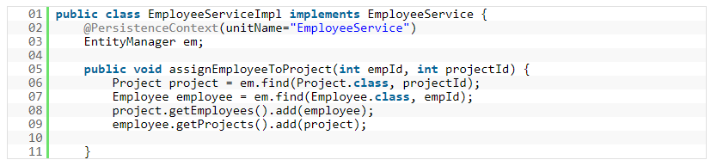
Container Managed Entity Manager
When a container of the application(be it a Java EE container or any other custom container like Spring) manages the lifecycle of the Entity Manager, the Entity Manager is said to be Container Managed.
The most common way of acquiring a Container Managed EntityManager is to use @PersistenceContext annotation on an EntityManager attribute.

Slide 7
Container Managed Entity Managers come in two flavors :
Transaction Scoped Entity Managers
Extended Scope Entity Managers
The biggest benefit of using Transaction Scoped Entity Manager is that it is stateless.
This also makes the Transaction Scoped EntityManager threadsafe and thus virtually maintenance free.
But we just said that an EntityManager manages the persistence state of an entity
and the persistence state of an entity is part of the persistence context that get injected into the EntityManager.
all Container Managed Entity Managers depend on JTA Transactions.
Every time an operation is invoked on an Entity Manager, the container proxy(the container creates a proxy around the entity manager while instantiating it ) checks for any existing Persistence Context on the JTA Transaction.
If it finds one, the Entity Manager will use this Persistence Context. If it doesnt find one, then it will create a new Persistence Context and associates it with the transaction.

Slide 8
In the above example the first line of assignEmployeeToProject method is calling a find method on the EntityManager.
The call to find will force the container to check for an existing transaction.
the container guarantees that a transaction is available whenever a method on the bean is called or not.
If the transaction doesnt exist, it will throw Exception.
If it exists, it will then check whether a Persistence Context exists.
Since its the first call to any method of the EntityManager, a persistence context is not available yet. The Entity Manager will then create one and use it to find the project bean instance.
In the next call to find, the Entity Manager already has an associated Transaction as well as the Persistence Context associated with it.
It uses the same transaction to find employee instance.
By the end of 2nd line in the method both project and employee instance are managed.
At the end of the method call, the transaction is committed and the managed instances of person and employee get persisted.
when the transaction is over, the Persistence Context goes away.

Slide 9
Transaction Management
Transactions are directly related to entities. Managing transactions essentially then would mean managing how entities lifecycle(create, update delete) is managed.
the only role of EntityManager is to determine the lifetime of the Persistence Context.
It plays no role in dictating how a Persistence Context should behave.
Whenever a transaction begins, a Persistence Context instance gets associated with it.
And when a Transaction ends(commits for example), the Persistence Context is flushed and get disassociated with the transaction.

Slide 10
Transaction management types
RESOURCE LOCAL Transactions
Resource local transactions refer to the native transactions of the JDBC Driver
A Resource Local transaction involves a single transactional resource, for example a JDBC Connection.
JTA or GLOBAL Transactions
JTA transactions refer to the transactions of the JEE server.
Whenever you need two or more resources(f or example a JMS Connection and a JDBC Connection) within a single transaction, you use JTA Transaction.
Application Managed Entity Managers can use either Resource Local Transactions or JTA transactions.
Container Managed Entity Managers always use JTA transactions as the container takes care of transaction life cycle management and spawning the transaction across multiple transactional resources.

Slide 11
Normally in JTA or global transaction, a third party transaction monitor enlists the different transactional resources within a transaction, prepares them for a commit and finally commits the transaction.
This process of first preparing the resources for transaction(by doing a dry run) and then committing(or rolling back) is called a 2 phase commit.
XA Protocol
In global transactions, a transaction monitor has to constantly talk to different transactional resources.
XA is a protocol specification that provides a common ground for the transaction monitor to interact with different transactional resources.
JTA is a global transaction monitor specification that speaks XA and thus is able to manage multiple transactional resources.

Slide 12
Persistence Context, Transactions and Entity Managers
A Persistence Context can be associated with either single or multiple transactions and can be associated with multiple Entity Managers.
A Persistence Context gets registered with a transaction so that persistence context can be flushed when a transaction is committed.
When a transaction starts, the Entity Manager looks for an active Persistence Context instance.
If it is not available it creates one and binds it to the transaction.
Normally the scope of the persistence context is tightly associated with the transaction. When a transaction ends, the persistence context instance associated with that transaction also ends.
But sometime, mostly in the Java EE world, we require transaction propagation, which is the process of sharing a single persistence context between different Entity Managers within a single transaction.

Slide 13
Persistence Contexts can have two scopes:
Transaction Scoped Persistence Context
Extended Scoped Persistence Context
A Transactional scoped Entity Manager creates a Transaction scoped Persistence Context.
An Extended Scope Entity Manager uses the Extended Persistence Context.
The lifecycle of the Extended Persistence Context is tied to the Stateful Session Bean in the Java EE environment.

Slide 14
ORM Mapping Directions
Unidirectional relationship
In this relationship, only one entity can refer the properties to another.
It contains only one owing side that specifies how an update can be made in the database.
Bidirectional relationship
This relationship contains an owning side as well as an inverse side.
So here every entity has a relationship field or refer the property to other entity.

Slide 15
Types of Mapping
One-to-one
This association is represented by @OneToOne annotation. Here, instance of each entity is related to a single instance of another entity.
One-to-many
This association is represented by @OneToMany annotation. In this relationship, an instance of one entity can be related to more than one instance of another entity.
Many-to-one
This mapping is defined by @ManyToOne annotation. In this relationship, multiple instances of an entity can be related to single instance of another entity.
Many-to-many
This association is represented by @ManyToMany annotation. Here, multiple instances of an entity can be related to multiple instances of another entity. In this mapping, any side can be the owing side.

Slide 16
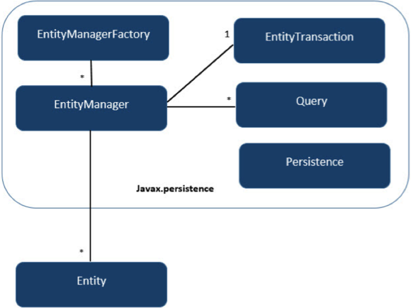
JPA Class Relationship
Units | Description
EntityManagerFactory | This is a factory class of EntityManager. It creates and manages multiple EntityManager instances.
EntityManager | It is an Interface, it manages the persistence operations on objects. It works like factory for Query instance.
Entity | Entities are the persistence objects, stores as records in the database.
EntityTransaction | It has one-to-one relationship with EntityManager. For each EntityManager, operations are maintained by EntityTransaction class.
Persistence | This class contain static methods to obtain EntityManagerFactory instance.
Query | This interface is implemented by each JPA vendor to obtain relational objects that meet the criteria.

Slide 17
Entity Entity Properties
Persistability
An object is called persistent if it is stored in the database and can be accessed anytime.
Persistent Identity
In Java, each entity is unique and represents as an object identity. Similarly, when the object identity is stored in a database then it is represented as persistence identity. This object identity is equivalent to primary key in database.
Transactionality
Entity can perform various operations such as create, delete, update. Each operation makes some changes in the database. It ensures that whatever changes made in the database either be succeed or failed atomically.
Granuality
Entities should not be primitives, primitive wrappers or built-in objects with single dimensional state.

Slide 18
Entity Metadata
Each entity is associated with some metadata that represents the information of it.
Instead of database, this metadata is exist either inside or outside the class.
This metadata can be in following forms:
Annotation - In Java, annotations are the form of tags that represents metadata. This metadata persist inside the class.
XML - In this form, metadata persist outside the class in XML file.

Slide 19
Annotations
Annotation | Description
@Entity | This annotation specifies to declare the class as entity or a table.
@Table | This annotation specifies to declare table name.
@Basic | This annotation specifies non constraint fields explicitly.
@Embedded | This annotation specifies the properties of class or an entity whose value instance of an embeddable class.
@Id | This annotation specifies the property, use for identity (primary key of a table) of the class.
@GeneratedValue | This annotation specifies, how the identity attribute can be initialized such as Automatic, manual, or value taken from sequence table.
@Transient | This annotation specifies the property which in not persistent i.e. the value is never stored into database.
@Column | This annotation is used to specify column or attribute for persistence property.
@SequenceGenerator | This annotation is used to define the value for the property which is specified in @GeneratedValue annotation. It creates a sequence.
@TableGenerator | This annotation is used to specify the value generator for property specified in @GeneratedValue annotation. It creates a table for value generation.

Slide 20
Annotation | Description
@AccessType | This type of annotation is used to set the access type. If you set @AccessType(FIELD) then Field wise access will occur. If you set @AccessType(PROPERTY) then Property wise assess will occur.
@JoinColumn | This annotation is used to specify an entity association or entity collection. This is used in many- to-one and one-to-many associations.
@UniqueConstraint | This annotation is used to specify the field, unique constraint for primary or secondary table.
@ColumnResult | This annotation references the name of a column in the SQL query using select clause.
@ManyToMany | This annotation is used to define a many-to-many relationship between the join Tables.
@ManyToOne | This annotation is used to define a many-to-one relationship between the join Tables.
@OneToMany | This annotation is used to define a one-to-many relationship between the join Tables.
@OneToOne | This annotation is used to define a one-to-one relationship between the join Tables.
@NamedQueries | This annotation is used for specifying list of named queries.
@NamedQuery | This annotation is used for specifying a Query using static name.

Slide 21
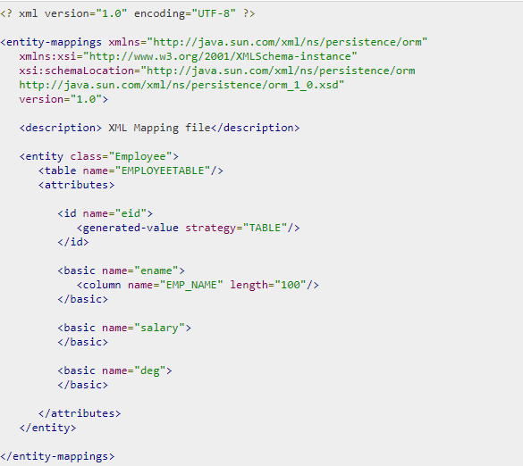
mapping.xml
ex

Slide 22
Java Bean Standard
Bean contains the default constructor or a file that contains serialized instance. Therefore, a bean can instantiate the bean.
Non-Boolean property contains getter and setter methods.
Getter method of any property should start with small lettered ‘get’ (java method convention) and continued with a field name that starts with capital letter. E.g. the field name is ‘salary’ therefore the getter method of this field is ‘getSalary ()’.
Setter method of any property should start with small lettered ‘set’ (java method convention), continued with a field name that starts with capital letter and the argument value to set to field. E.g. the field name is ‘salary’ therefore the setter method of this field is ‘setSalary (double sal)’.
Boolean property contain setter and is method.
For Boolean property, is method to check if it is true or false. E.g. the Boolean property ‘empty’, the is method of this field is ‘isEmpty ()’.

Slide 23
Entity Class
@Entity
@Table(name="PERSON")
public class Person {
@Id
@Column(name="id")
@GeneratedValue(strategy=GenerationType.IDENTITY)
private int id;
private String name;
public int getId() {
return id;
}
public void setId(int id) {
this.id = id;
}
public String getName() {
return name;
}
public void setName(String name) {
this.name = name;
}
@Override
public String toString(){
return "id="+id+", name="+name+", country="+country;
}
}
ex

Slide 24
Entity manager
similar to the Hibernate Session class
entity manager is not expected to be thread safe (don't inject it into a servlet class variable which is visible to multiple threads).

Slide 25
Application-managed entity managers
Application-managed entity managers provide direct access to the underlying persistence provider (org.hibernate.ejb.HibernatePersistence).
The scope of the application-managed entity manager is from when the application creates it and lasts until the app closes it.
Use the @PersistenceUnit annotation to inject a persistence unit into a javax.persistence.EntityManagerFactory.
The EntityManagerFactory can return an application-managed entity manager.

Slide 26
Container-managed entity manager
Container-managed entity managers auto-magically manage the underlying persistence provider for the application.
Container-managed entity managers may use transaction-scoped persistence contexts or extended persistence contexts.
The container-managed entity manager will create instances of the underlying persistence provider as needed.
Every time that a new underlying persistence provider (org.hibernate.ejb.HibernatePersistence) instance is created, a new persistence context is also created (as an implementation detail of the underlying persistence provider).

Slide 27
Persistence Context
The JPA persistence context contains the entities managed by the persistence provider.
The persistence context acts like a first level (transactional) cache for interacting with the datasource.
Loaded entities are placed into the persistence context before being returned to the application.
Entities changes are also placed into the persistence context (to be saved in the database when the transaction commits).

Slide 28
Transaction-scoped Persistence Context
The transaction-scoped persistence context coordinates with the (active) JTA transaction.
When the transaction commits, the persistence context is flushed to the datasource (entity objects are detached but may still be referenced by application code).
All entity changes that are expected to be saved to the datasource, must be made during a transaction.
Entities read outside of a transaction will be detached when the entity manager invocation completes.

Slide 29
Extended Persistence Context
The (ee container managed) extended persistence context can span multiple transactions and allows data modifications to be queued up (like a shopping cart), without an active JTA transaction (to be applied during the next JTA TX).
The Container-managed extended persistence context can only be injected into a stateful session bean.

Slide 30
Entities - lifecycle
New (transient):
an entity is new if it has just been instantiated using the new operator, and it is not associated with a persistence context.
It has no persistent representation in the database and no identifier value has been assigned.
Managed (persistent):
a managed entity instance is an instance with a persistent identity that is currently associated with a persistence context.
Detached:
the entity instance is an instance with a persistent identity that is no longer associated with a persistence context, usually because the persistence context was closed or the instance was evicted from the context.
Removed:
a removed entity instance is an instance with a persistent identity, associated with a persistence context, but scheduled for removal from the database.

Slide 31
persistence.xml
a standard configuration file
has to be included in the META-INF directory inside the JAR file that contains the entity beans.
define a persistence-unit with a unique name in the current scoped classloader.
The provider attribute specifies the underlying implementation of the JPA EntityManager.

Slide 32
JPA basic program example
EntityManagerFactory emFactory = Persistence.createEntityManagerFactory( "LOCAL_PERSISTENCE" );
EntityManager entityManager = emFactory.createEntityManager( );
entityManager.getTransaction( ).begin( );
Person person = new Person();
person.setName("Elvin");
person.setCountry("Denmark");
entityManager.persist(person);
System.out.println("create: " + person.toString());
entityManager.getTransaction().commit();
entityManager.close();
emFactory.close();

Slide 33
Java Persistence Query language
JPQL syntax is very similar to the syntax of SQL.
SQL works directly against relational database tables, records and fields, whereas JPQL works with Java classes and instances.

Slide 34
EntityManagerFactory emFactory = Persistence.createEntityManagerFactory( "LOCAL_PERSISTENCE" );
EntityManager entityManager = emFactory.createEntityManager( );
entityManager.getTransaction( ).begin( );
Query query = entityManager.createQuery("from Person p");
List<Person> personList = query.getResultList();
for (Person item: personList) {
System.out.println("list: " + item.toString());
}
entityManager.getTransaction().commit();
entityManager.close();
emFactory.close();

Slide 35
Basic
from Person p
select p from Person p
Between, And, Like Keywords
Select e from Employee e where e.salary Between 30000 and 40000
Select e from Employee e where e.ename LIKE 'M%'
Ordering
Select e from Employee e ORDER BY e.ename ASC

Slide 36
Named Queries
A @NamedQuery annotation is defined as a query with a predefined unchangeable query string.
Instead of dynamic queries, usage of named queries may improve code organization by separating the JPQL query strings from POJO.
It also passes the query parameters rather than embedding literals dynamically into the query string and results in more efficient queries.

Slide 37
Eager and Lazy Loading
The main concept of JPA is to make a duplicate copy of the database in cache memory. While transacting with the database, first it will effect on duplicate data and only when it is committed using entity manager, the changes are effected into the database.
Eager fetch
Fetching the whole record while finding the record using Primary Key.
Lazy fetch
It checks for the availability of entities with primary key if it exists. Then later if you call any of the getter method of that entity then it fetches the whole.
The default depends on the cardinality of the relationship.
All to-one relationships use FetchType.EAGER by default
all to-many relationships FetchType.LAZY by default

Slide 38
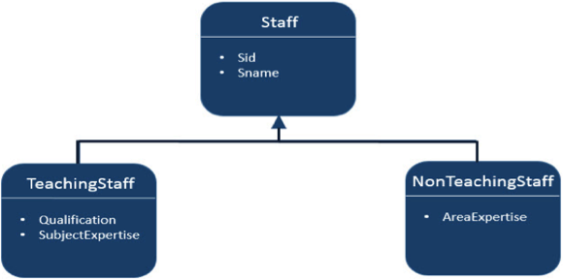
Inheritance Strategies
JPA support three types of inheritance strategies such as SINGLE_TABLE, JOINED_TABLE, and TABLE_PER_CONCRETE_CLASS.

Slide 39
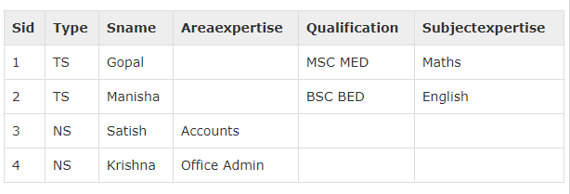
Single Table strategy
@Id @GeneratedValue( strategy = GenerationType.AUTO )
Single-Table strategy takes all classes fields (both super and sub classes) and map them down into a single table known as SINGLE_TABLE strategy.
Here discriminator value plays key role in differentiating the values of three entities in one table.
Finally you will get single table which contains all three class’s fields and differs with discriminator column named ‘Type’ (field)

Slide 40
private int sid; private String sname;
@Entity
@Table
@Inheritance( strategy = InheritanceType.SINGLE_TABLE )
@DiscriminatorColumn( name = "type" )
public class Staff implements Serializable {
@Id
@GeneratedValue( strategy = GenerationType.AUTO )
private int sid;
private String sname;
@Entity
@DiscriminatorValue( value="TS" )
public class TeachingStaff extends Staff {
private String qualification;
private String subjectexpertise;
@Entity
@DiscriminatorValue( value = "NS" )
public class NonTeachingStaff extends Staff {
private String areaexpertise;

Slide 41
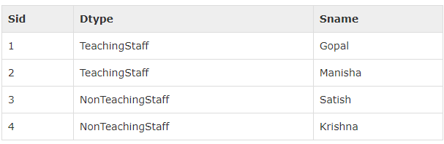
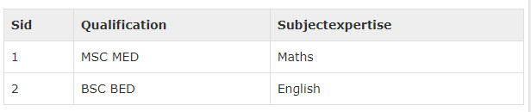
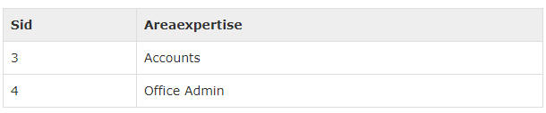
Joined table Strategy
Joined table strategy is to share the referenced column which contains unique values to join the table and make easy transactions.
Here three tables are created: Staff, TeachingStaff, NonTeachingStaff

Slide 42
@Entity
@Table
@Inheritance( strategy = InheritanceType.JOINED )
public class Staff implements Serializable {
@Id
@GeneratedValue( strategy = GenerationType.AUTO )
private int sid;
private String sname;
@Entity
@PrimaryKeyJoinColumn(referencedColumnName="sid")
public class TeachingStaff extends Staff {
private String qualification;
private String subjectexpertise;
@Entity
@PrimaryKeyJoinColumn(referencedColumnName="sid")
public class NonTeachingStaff extends Staff {
private String areaexpertise;

Slide 43
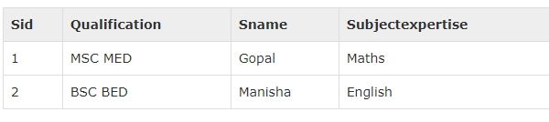
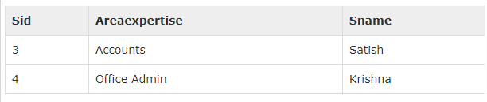
Table per class strategy
Table per class strategy is to create a table for each sub entity.
The staff table will be created but it will contain null records.
The field values of Staff table must be shared by TeachingStaff and NonTeachingStaff tables.
Here the three tables are created
Staff table contains null records.
TeachingStaff, NonTeachingStaff

Slide 44
@Entity
@Table
@Inheritance( strategy = InheritanceType.TABLE_PER_CLASS )
public class Staff implements Serializable {
@Id
@GeneratedValue( strategy = GenerationType.AUTO )
private int sid;
private String sname;
@Entity
public class TeachingStaff extends Staff {
private String qualification;
private String subjectexpertise;
@Entity
public class NonTeachingStaff extends Staff {
private String areaexpertise;

Slide 45
relationships between Entities
@ManyToOne Relation
@OneToMany Relation
@OneToOne Relation
@ManyToMany Relation

Slide 46
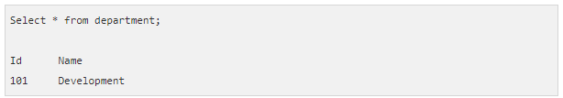
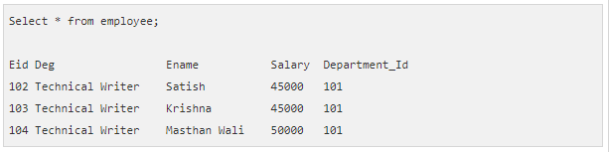
@ManyToOne Relation
Many-To-One relation between entities:
Where one entity (column or set of columns) is/are referenced with another entity (column or set of columns) which contain unique values.
In relational databases these relations are applicable by using foreign key/primary key between tables.

Slide 47
@Entity
public class Employee{
@Id
@GeneratedValue( strategy= GenerationType.AUTO )
private int eid;
private String ename;
private double salary;
private String deg;
@ManyToOne
private Department department;
@Entity
public class Department {
@Id
@GeneratedValue( strategy=GenerationType.AUTO )
private int id;
private String name;

Slide 48
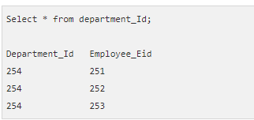
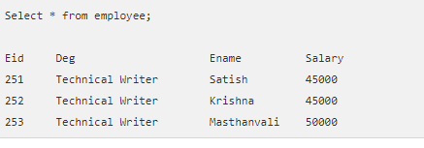
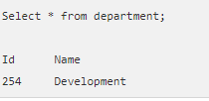
@OneToMany Relation
In this relationship each row of one entity is referenced to many child records in other entity.
The important thing is that child records cannot have multiple parents.

Slide 49
@Entity
public class Employee {
@Id
@GeneratedValue( strategy= GenerationType.AUTO )
private int eid;
private String ename;
private double salary;
private String deg;
@Entity
public class Department {
@Id
@GeneratedValue( strategy=GenerationType.AUTO )
private int id;
private String name;
@OneToMany( targetEntity=Employee.class )
private List employeelist;

Slide 50
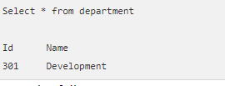
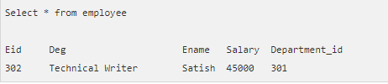
@OneToOne Relation
In One-To-One relationship, one item can belong to only one other item.
It means each row of one entity is referred to one and only one row of another entity.

Slide 51
@Entity
public class Employee {
@Id
@GeneratedValue( strategy= GenerationType.AUTO )
private int eid;
private String ename;
private double salary;
private String deg;
@OneToOne
private Department department;
@Entity
public class Department {
@Id
@GeneratedValue( strategy=GenerationType.AUTO )
private int id;
private String name;

Slide 52
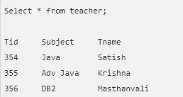
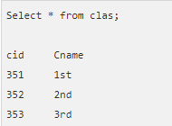
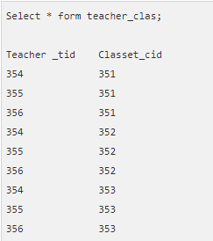
@ManyToMany Relation
Many-To-Many relationship is where one or more rows from one entity are associated with more than one row in other entity.

Slide 53
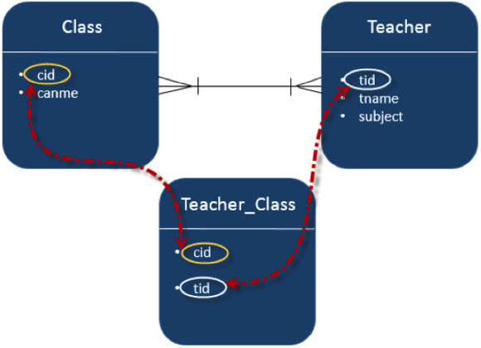
@Entity
public class Clas {
@Id
@GeneratedValue( strategy = GenerationType.AUTO )
private int cid;
private String cname;
@ManyToMany(targetEntity=Teacher.class)
private Set teacherSet;
@Entity
public class Teacher {
@Id
@GeneratedValue( strategy = GenerationType.AUTO )
private int tid;
private String tname;
private String subject;
@ManyToMany(targetEntity = Clas.class)
private Set clasSet;

Slide 54
Criteria API
The Criteria API is a predefined API used to define queries for entities.
It is the alternative way of defining a JPQL query.
These queries are type-safe, and portable and easy to modify by changing the syntax.
Similar to JPQL it follows abstract schema (easy to edit schema) and embedded objects.
The metadata API is mingled with criteria API to model persistent entity for criteria queries.
The major advantage of the criteria API
is that errors can be detected earlier during compile time.
String based JPQL queries and JPA criteria based queries are same in performance and efficiency.

Slide 55
JPA defines a persistence unit through the META-INF/persistence.xml file.
Starting with Spring 3.1, the persistence.xml is no longer necessary – the LocalContainerEntityManagerFactoryBean now supports a ‘packagesToScan’ property where the packages to scan for @Entity classes can be specified.

Slide 56
Criteria Query Structure
EntityManager em = ...;
CriteriaBuilder cb = em.getCriteriaBuilder();
CriteriaQuery<Entity class> cq = cb.createQuery(Entity.class);
Root<Entity> from = cq.from(Entity.class);
cq.select(Entity);
TypedQuery<Entity> q = em.createQuery(cq);
List<Entity> allitems = q.getResultList();
EntityManager instance is used to create a CriteriaBuilder object.
CriteriaQuery instance is used to create a query object. This query object’s attributes will be modified with the details of the query.
CriteriaQuery.from method is called to set the query root.
CriteriaQuery.select is called to set the result list type.
TypedQuery<T> instance is used to prepare a query for execution and specifying the type of the query result.
getResultList method on the TypedQuery<T> object to execute a query. This query returns a collection of entities, the result is stored in a List.

Slide 58
Enviorment
Java 8
tomcat 7.x
spring 4.3
hibernate 4.3 + jpa 2.1
postgresql 8.4

Slide 59
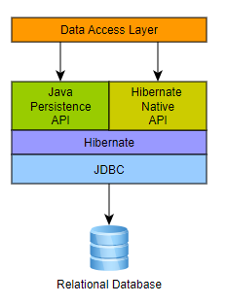
Hibernate ORM
Supported JPA Versions
JPA 1.0: ORM 3.2+
JPA 2.0: ORM 3.5+
JPA 2.1: ORM 4.3+
JPA 2.2: ORM 5.3+

Slide 60
Native SQL Queries
List<Object[]> persons = entityManager.createNativeQuery(
“SELECT * FROM Person" )
.getResultList();
for(Object[] person : persons) {
Number id = (Number) person[0];
String name = (String) person[1];
}
These will return a List of Object arrays ( Object[] ) with scalar values for each column in the PERSON table.
Hibernate will use java.sql.ResultSetMetadata to deduce the actual order and types of the returned scalar values.

Slide 61
List<Object[]> persons = session.createNativeQuery( "SELECT * FROM Person" )
.addScalar( "id", LongType.INSTANCE )
.addScalar( "name", StringType.INSTANCE )
.list();
for(Object[] person : persons) {
Long id = (Long) person[0];
String name = (String) person[1];
}
To avoid the overhead of using ResultSetMetadata, or simply to be more explicit in what is returned, one can use addScalar():

Slide 62
the following query will also return a List where each element is a Person entity.
List<Person> persons = entityManager.createNativeQuery(
“SELECT * FROM Person", Person.class )
.getResultList();

Slide 63
Dao

Slide 64
Boundary
Service
Interface
Dao
Interface
Entity
ServiceImpl
DaoImpl

Slide 65
with persistence.xml

Slide 66
Persistence.xml
<persistence xmlns="http://xmlns.jcp.org/xml/ns/persistence"
xmlns:xsi="http://www.w3.org/2001/XMLSchema-instance"
xsi:schemaLocation="http://xmlns.jcp.org/xml/ns/persistence
http://xmlns.jcp.org/xml/ns/persistence/persistence_2_1.xsd"
version="2.1">
<persistence-unit name="LOCAL_PERSISTENCE">
<description> Spring Hibernate JPA Configuration Example</description>
<provider>org.hibernate.jpa.HibernatePersistenceProvider</provider>
<!-- jdbc configuration -->
<properties>
<property name="javax.persistence.jdbc.driver" value="org.postgresql.Driver" />
<property name="javax.persistence.jdbc.url" value="jdbc:postgresql://localhost:5432/test_db" />
<property name="javax.persistence.jdbc.user" value="test_user" />
<property name="javax.persistence.jdbc.password" value="test_password" />
<property name="hibernate.dialect" value="org.hibernate.dialect.PostgreSQLDialect" />
<property name="hibernate.show_sql" value="true" />
</properties>
</persistence-unit>
</persistence>

Slide 67
spring configuration
add
<bean id="entityManagerFactory" class="org.springframework.orm.jpa.LocalContainerEntityManagerFactoryBean">
<property name="persistenceUnitName" value="LOCAL_PERSISTENCE"/>
</bean>

Slide 68
Dao
add @Repository
@Repository
public class PersonDAOImpl implements PersonDAO {
private static final Logger logger = LoggerFactory.getLogger(PersonDAOImpl.class);
@PersistenceContext
EntityManager entityManager;

Slide 70
without persistence.xml

Slide 71
Spring configuration example
Spring configuration
<bean id="entityManagerFactory" class="org.springframework.orm.jpa.LocalContainerEntityManagerFactoryBean">
<property name="dataSource" ref="dataSource" />
<property name="packagesToScan" value=“my.test.model" />
<property name="jpaVendorAdapter">
<bean class="org.springframework.orm.jpa.vendor.HibernateJpaVendorAdapter" />
</property>
<property name="jpaProperties">
<props>
<prop key="hibernate.dialect">org.hibernate.dialect.PostgreSQLDialect</prop>
<prop key="hibernate.show_sql">true</prop>
</props>
</property>
</bean>
<bean id="dataSource" class="org.apache.commons.dbcp2.BasicDataSource" destroy-method="close">
<property name="driverClassName" value="org.postgresql.Driver" />
<property name="url" value="jdbc:postgresql://localhost:5432/test_db" />
<property name="username" value="test_user" />
<property name="password" value="test_password" />
</bean>

Slide 73
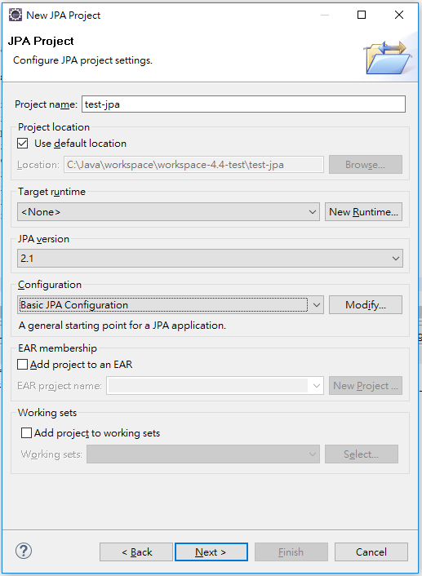
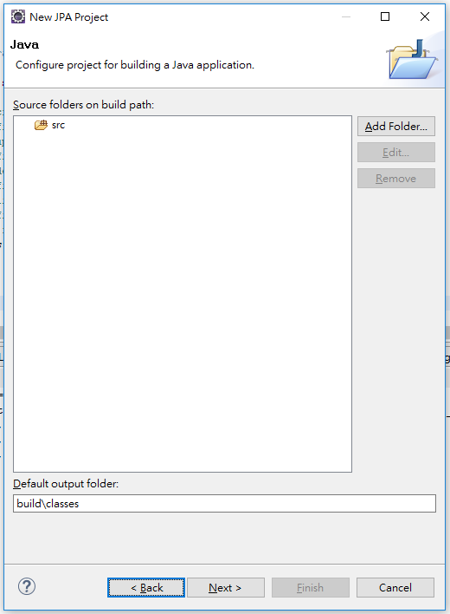
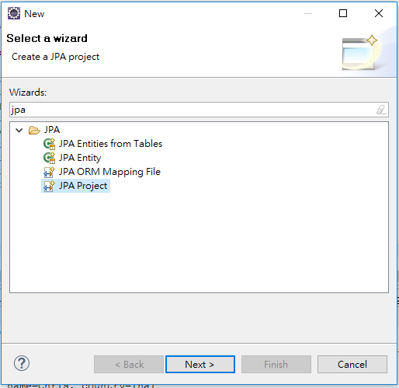
eclipse JPA Project

Slide 74
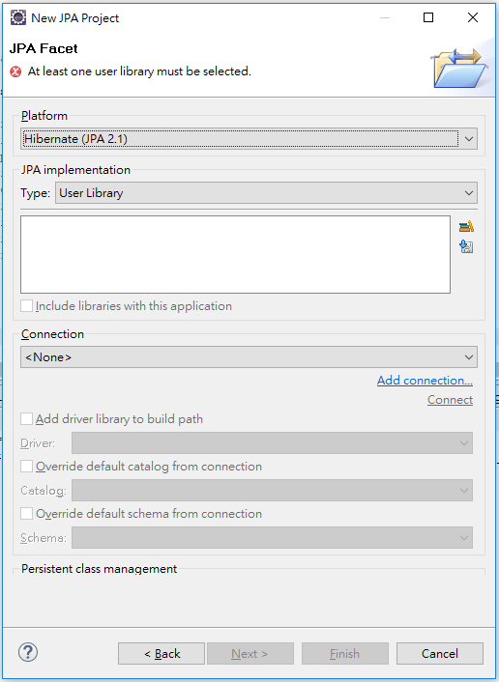
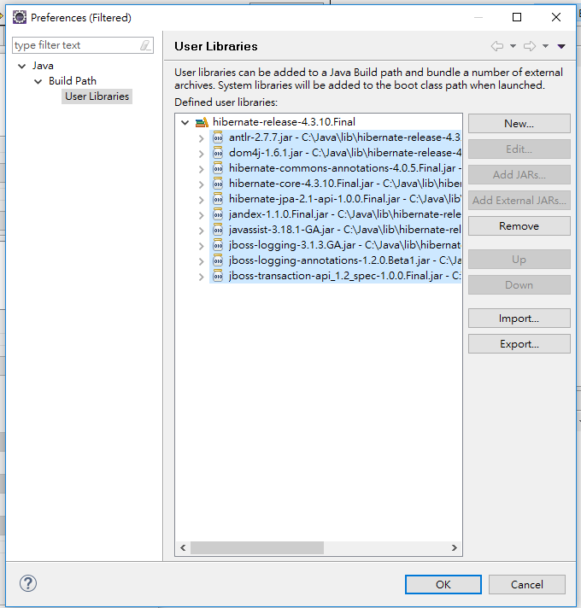

Slide 75
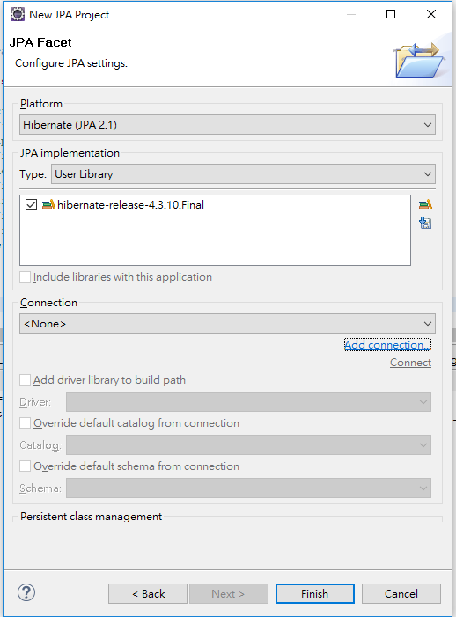
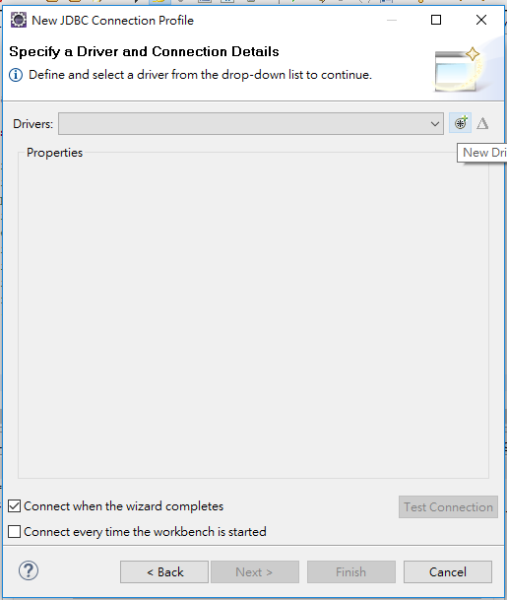
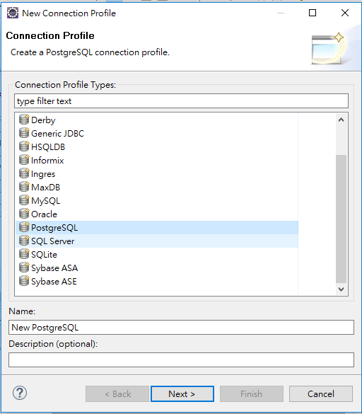

Slide 76
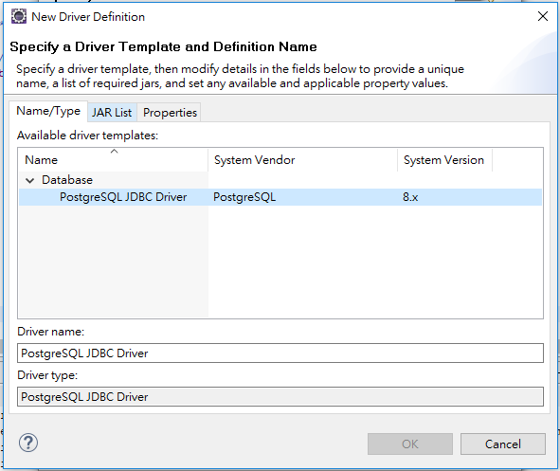
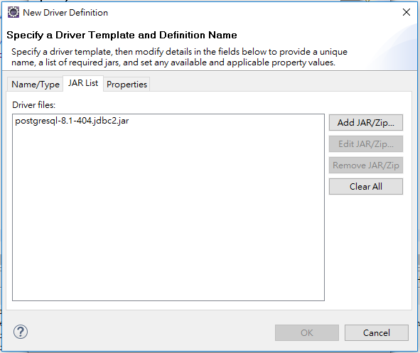
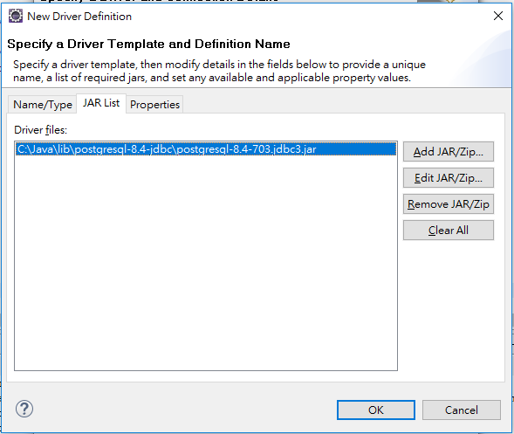

Slide 77
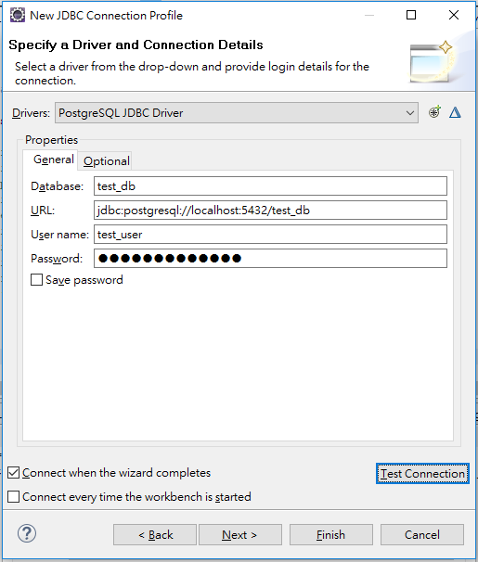
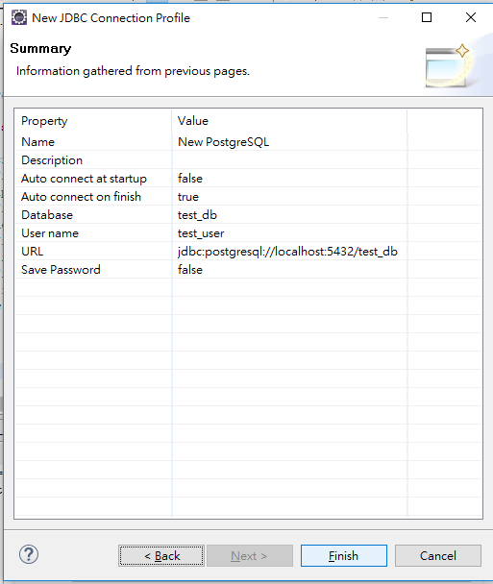

Slide 78
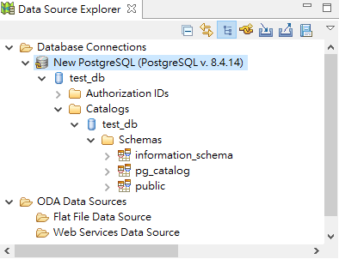
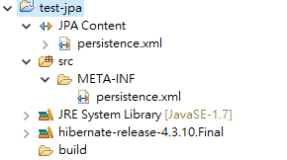

Slide 79
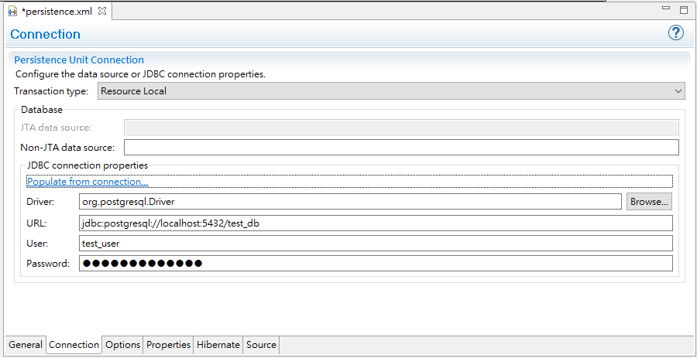
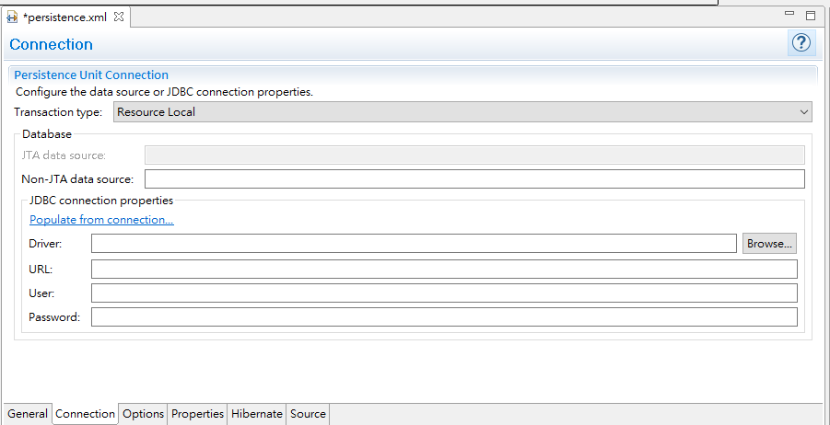

Slide 80
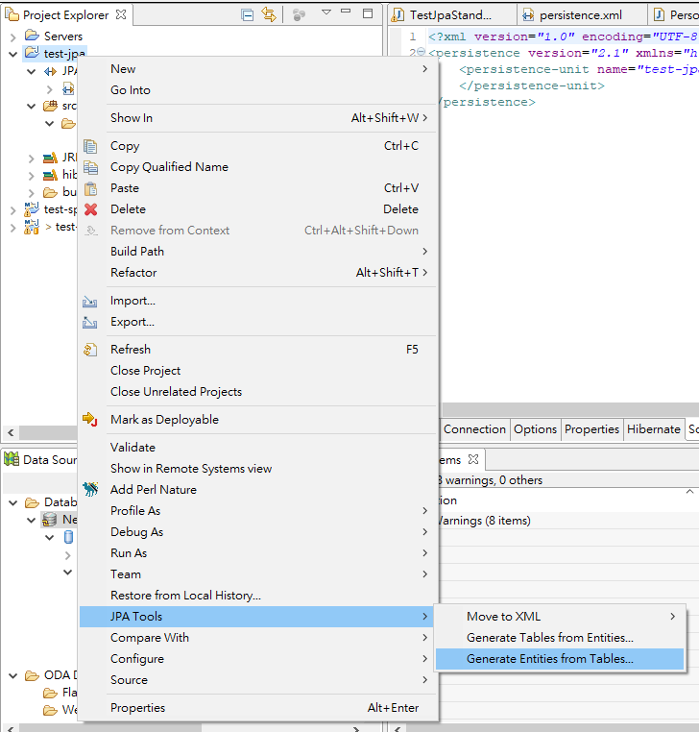
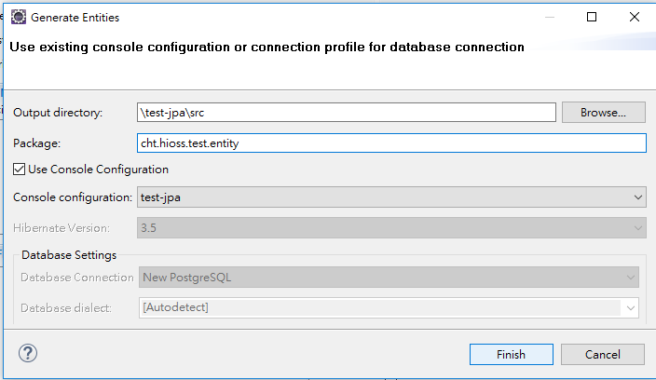

Slide 81
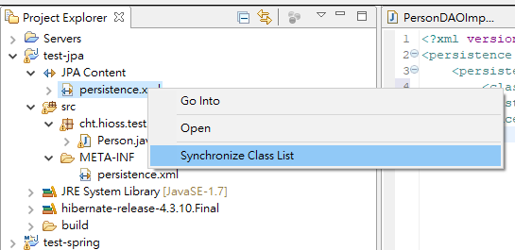
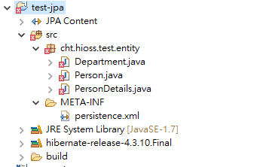

Slide 82
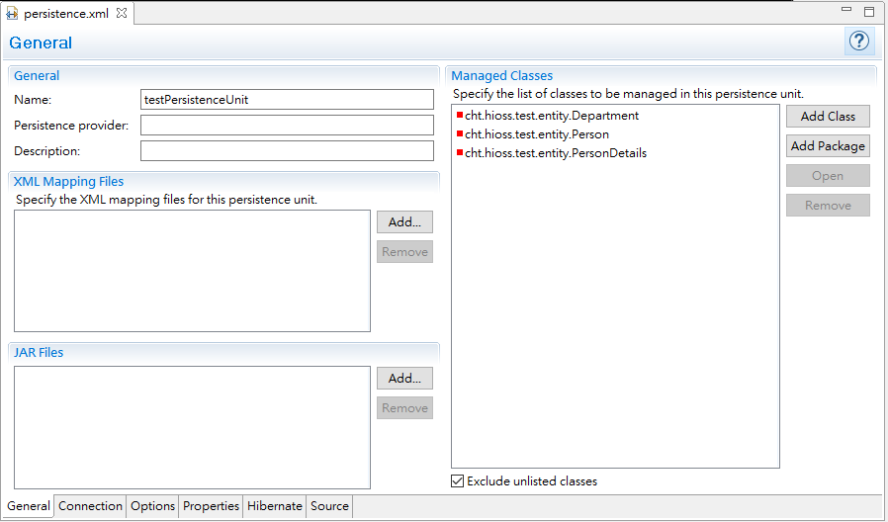
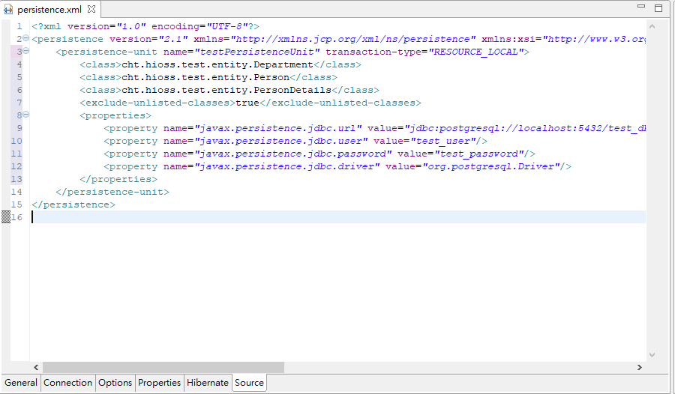

Slide 83
references
Hibernate ORM 5.3.7.Final User Guide
http://docs.jboss.org/hibernate/orm/5.3/userguide/html_single/Hibernate_User_Guide.html
JPA Tutorial
https://www.tutorialspoint.com/jpa/index.htm
JPA Tutorial
https://www.javatpoint.com/jpa-tutorial
A Guide to JPA with Spring
https://www.baeldung.com/the-persistence-layer-with-spring-and-jpa

